Slide 1

Exploring Index based Pooling and Un-pooling
January 5 2022
Kichang Lee
Yonsei University

Slide 2
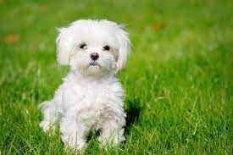
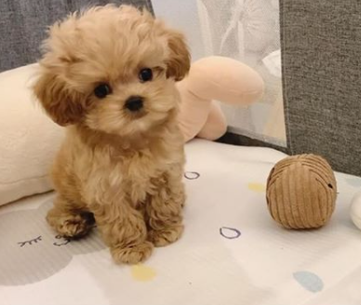

Introduction
Feature Mixing (희망편)
Encoder
Feature
New Mixed Feature
Decoder
Encoder
Feature
Feature Mixing Pipeline
Output
Input

Slide 3
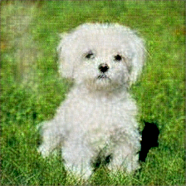
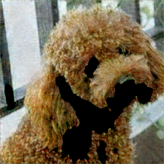
Introduction
Feature Mixing (절망편)
Encoder
Feature
Decoder
New Mixed Feature
Encoder
Feature
Decoder
Feature Mixing Pipeline
Output
Input

Slide 4
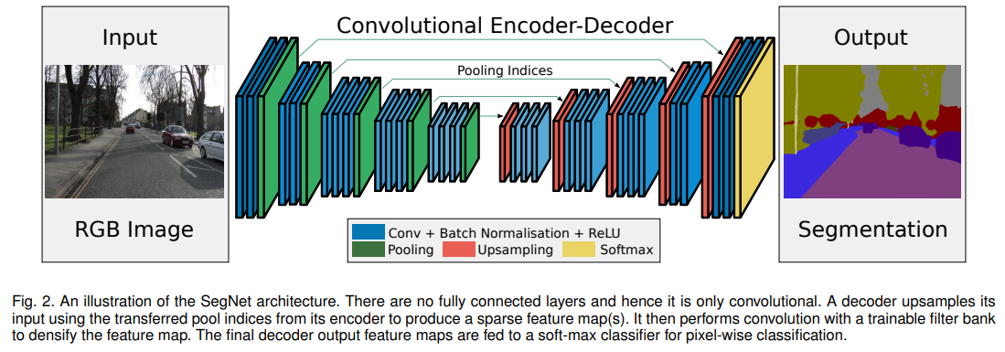

Model Architecture
Model Architecture : SegNet
SegNet: A Deep Convolutional Encoder-Decoder Architecture for Image Segmentation (9630 Citetion)
Vijay Badrinarayanan, Alex Kendall, Roberto Cipolla

Slide 5
Exploration 1
Feature Mixing
Another
Feature 1
Another
Feature 2
Encoder
Original Feature
Decoder
?
Random
Value
Zeros
Feature Mixing Pipeline
Input

Slide 6
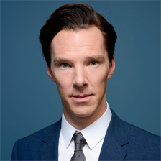
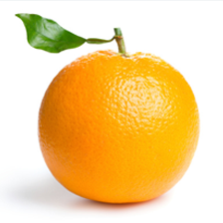

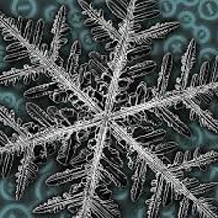
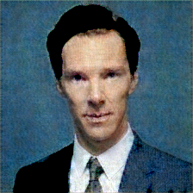
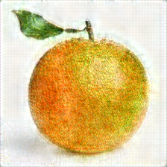
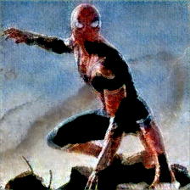
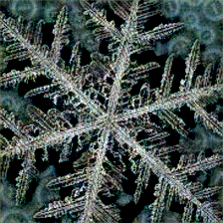
Exploration 2
Image Reconstruction with OOD Sample

Slide 7
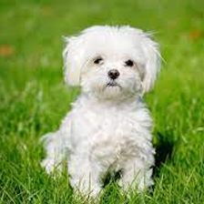
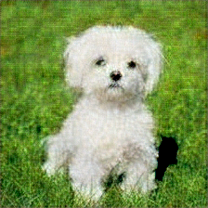
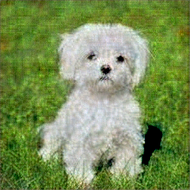
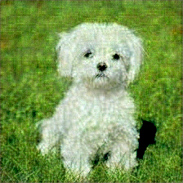
Exploration 3
Feature Mixing
Input
Reconstructed
Random Value
Zeros

Slide 8
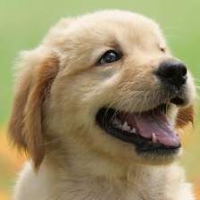
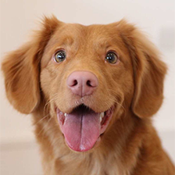
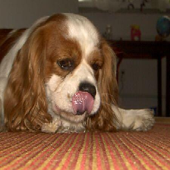

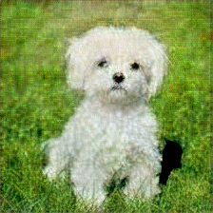
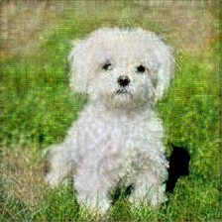
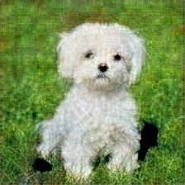
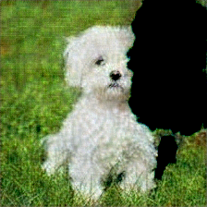
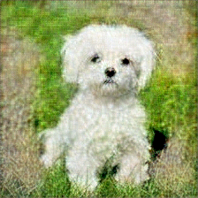
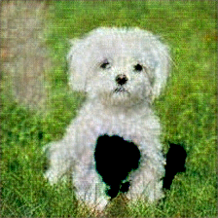
Exploration 3
Feature Mixing

Slide 9
Thank you!
Kichang Lee
1kichang@yonsei.ac.kr
http://www.eis-lab.org

